Slide 1

Learning Community Embedding with Community Detection and Node Embedding on Graphs

Slide 2
Introduce
node embedding can help improve community detection
community embedding can be used to optimize the node embedding by introducing a community-aware high-order proximity

Slide 3
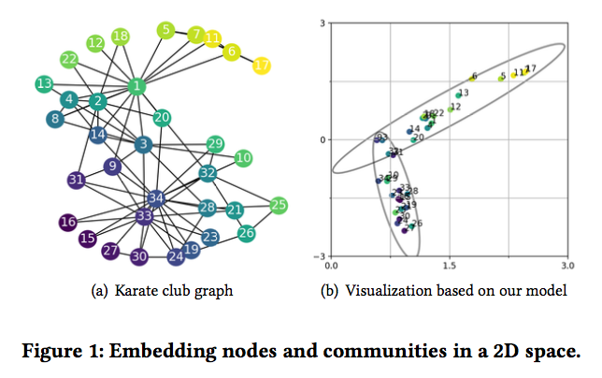
Introduce
cannot simply de ne a community embedding as a vector
we need to de ne it as a distribution in the low-dimensional space

Slide 4
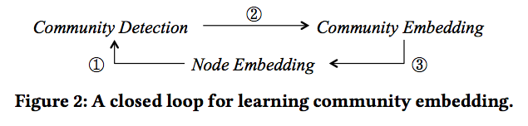
Introduce
a closed loop among community embedding, community detection and node embedding
Notes:
这篇文章是第一个提出 community embedding 的文章，思路为先利用 line 的方法训练 first order loss 和 second order loss 得到 embedding，然后使用 GMM 模型进行聚类（下图(3)过程），得到 community embedding（下图(1)）过程。文章的主要贡献在于实现了(2)过程，从而完成了下面的闭环。得到的模型既能进行 node embedding ，也能进行 commuity detection。

Slide 5



Node embedding
First order loss
Second order loss
Notes:
sigmoid

Slide 6
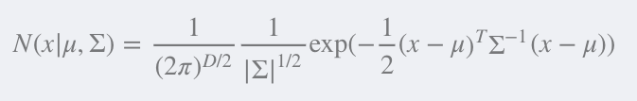
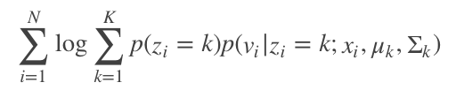
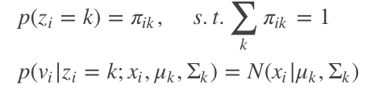
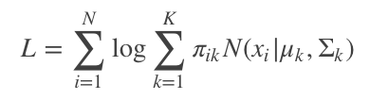
Community Detection and Embedding
Gaussian distribution :
Notes:
输入：节点的embedding 输出：节点属于每个社团的概率，每个社团的分布

Slide 7
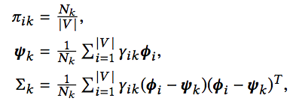

Community Detection and Embedding
Optimize: EM
E:
M:
Notes:
表示属于k类的点的概率和。

Slide 8



community embedding -> node embedding
Notes:
把 μ,Σμ,Σ 看做已知参数，通过迭代修改 x 的值来优化 L，这样能够使得同一个社团的节点的embedding能够靠近

Slide 9
Experiments
We evaluate ComE on multiple real-world datasets with various application tasks. It renders better graph visualization results, and also improves the state-of-the-art baselines by at least 6.6% (NMI) and 2.2%–16.9% (conductance) in community detection, 0.8%–26.9% (macro-F1) and 0.71%–48% (micro-F1) in node classification.
(Conductance is basically a ratio between the number of edges leaving a community and that within the community.
NMI measures the closeness between the predicted communities with ground truth based on the node labels.
Micro- F1 is the overall F1
Macro-F1 is the average of F1 scores )

